Slide 1
Chapter-12
Data Analysis and Interpretation
Topics Discussed
GETTING DATA READY FOR ANALYSIS
Editing data
Handling Blank Responses
Coding
Categorizing
Entering Data
DATA ANALYSIS
Basic Objectives in Data Analysis
    Feel for the Data
    Testing Goodness of Data
    Hypothesis Testing
DATA ANALYSIS AND INTERPRETATION
Use of Several Data-Analysis Techniques
    Descriptive Statistics
    Inferential Statistics
SOFTWARE PACKAGES FOR DATA ANALYSIS

Slide 2
Getting Data ready for Analysis
After data are obtained through questionnaires, interviews, observation, or through secondary sources, they need to be edited. The blank responses, if any, have to be handled in some way, the data coded, and a categorization scheme has to be set up. The data will then have to be keyed in, and some software program used to analyze them.
EDITING DATA
Data have to be edited, especially when they relate to responses to open-ended questions of interviews and questionnaires, or unstructured observation. In other words, information that may have been noted down by the interviewer, observer or researcher in a hurry must be clearly deciphered so that it may be coded systematically in its entirety. It is recommended that such editing should be done preferably the very same day the data are collected so that the respondents may be contacted for any further information or clarifications, as needed.

Slide 3
Getting Data ready for Analysis (contd..)
HANDILING BLANK RESPONSES
There are many ways of handling blank responses. A common approach is either to give the midpoint in the scale as the value or to ignore the particular item during the analysis. The computer can be programmed to handle missing and “ don’t know” responses in the manner we decide to deal with.

Slide 4
Getting Data ready for Analysis (contd..)
CODING
The next step is to code the responses. Different variables are coded for the purpose of easy analysis.
Example
At least 10% of the coded questionnaire should be checked for coding accuracy.
1.Age (years) | 2.Education | 3.Job level | 4.Work Shift | 5.Sex
Under 25 | 1. High School | 1.Manager | First | Male
2. 25-35 | 2. Some College | 2. Supervisor | 2. Second | 2.Female
3. 36-45 | 3. Bachelor’s Degree | 3. Clerk | 3. Third
4. Over 45 | 4.Other (specify) | 4.Other (specify)

Slide 5
Getting Data ready for Analysis (contd..)
CATEGORIZATION
At his point it is useful to set up a scheme for categorizing the variables such that the several items measuring a concept are all grouped together. Responses to some of the negatively worded questions have also to be reversed so that all answers are in the same direction.
ENTERING DATA
If questionnaire data are not collected on scanner answer sheets, which can be directly entered into the computer as a data file, the raw data will l have to be manually keyed into the computer. Raw data can be entered through any software program (SPSS).

Slide 6
Data Analysis
Basic objectives in Data Analysis
In data analysis we have three objectives: getting a feel for the data, testing the goodness of data and testing the hypotheses developed for the research
Feel of the Data
We can acquire a feel for the data by checking the central tendency and the dispersion. The mean, the range, the standard deviation, and the variance in the data will give the researcher a good idea of how the respondents have reacted to the items in the questionnaire and how good the items and measures are. The maximum and minimum scores, mean , standard deviation, variance, and other statistics can be easily obtained and these will indicate whether the responses range satisfactorily over the scale.
Testing Goodness of Data
  Reliability (split half, parallel form and test-retest reliability)
  Validity (criterion related, convergent, discriminant validity)
  Testing Hypotheses : Once the data are ready for analysis, the researcher is ready to test the hypotheses already developed by applying appropriate statistical tests.

Slide 7
Data Analysis and Interpretation
USE OF SEVERAL DATA-ANALYSIS TECHNIQUES
Descriptive Statistics
  Measures of Central Tendency
  Dispersion
Inferential Statistics
  Correlation
  t-test
  Multiple Regression etc.

Slide 8
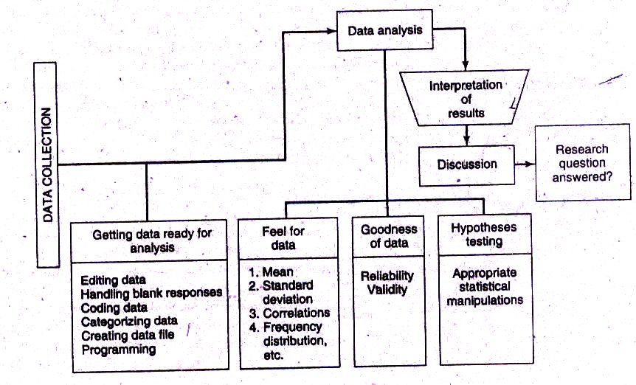
Flow Diagram of Data Analysis Process

